Slide 1
New: Extended Security Updates Enabled by Arc
Capture new ACR sockets via Azure Arc & enable and accelerate future migration scenarios
What is it?
Announced publicly at Inspire, Extended Security Updates (ESUs) enabled by Azure Arc is a new and enhanced cloud experience alternative to traditional Extended Security Updates (classic).
The new Extended Security Updates offering is now available for Windows 2012/2012 R2 and SQL Server 2012 through a pay-as-you-go subscription, giving your customers more flexibility to upgrade or migrate at their pace compared to the traditional ESU which will continue to be available through Volume Licensing Service Center
What’s in it for customers?
Native enrolment of ESU’s in Azure portal, keyless activation compared to classic ESU.
Access to trusted security and cloud capabilities including discovery, management and patching, all in one offering. Compatible with 3rd party patch management solutions.
Access the use of Azure Resource Manager, tagging, Role Based Access Control (RBAC), and Azure management services at no additional cost.
Flexible, monthly PAYG subscription; retire cost once upgraded or migrated. Larger discounts available compared to classic ESU via field empowerment.
Notes:
Note: discounts for Arc ESU cannot be stacked with ACD or EA discounts.
Pricing and ACR potential examples:
Arc ESU: Windows Server 2012 Datacenter 16 Core - $436/server/month > 44K per month for 100 servers protected by Arc ESU!
Is Software Assurance (SA) required to take advantage of Extended Security Updates (ESU)?
On–prem: Yes, SA is required for on-premises workloads.
In Azure: No, for workloads running in Azure, ESU is free and does not require SA (unless using AHB)

Slide 2

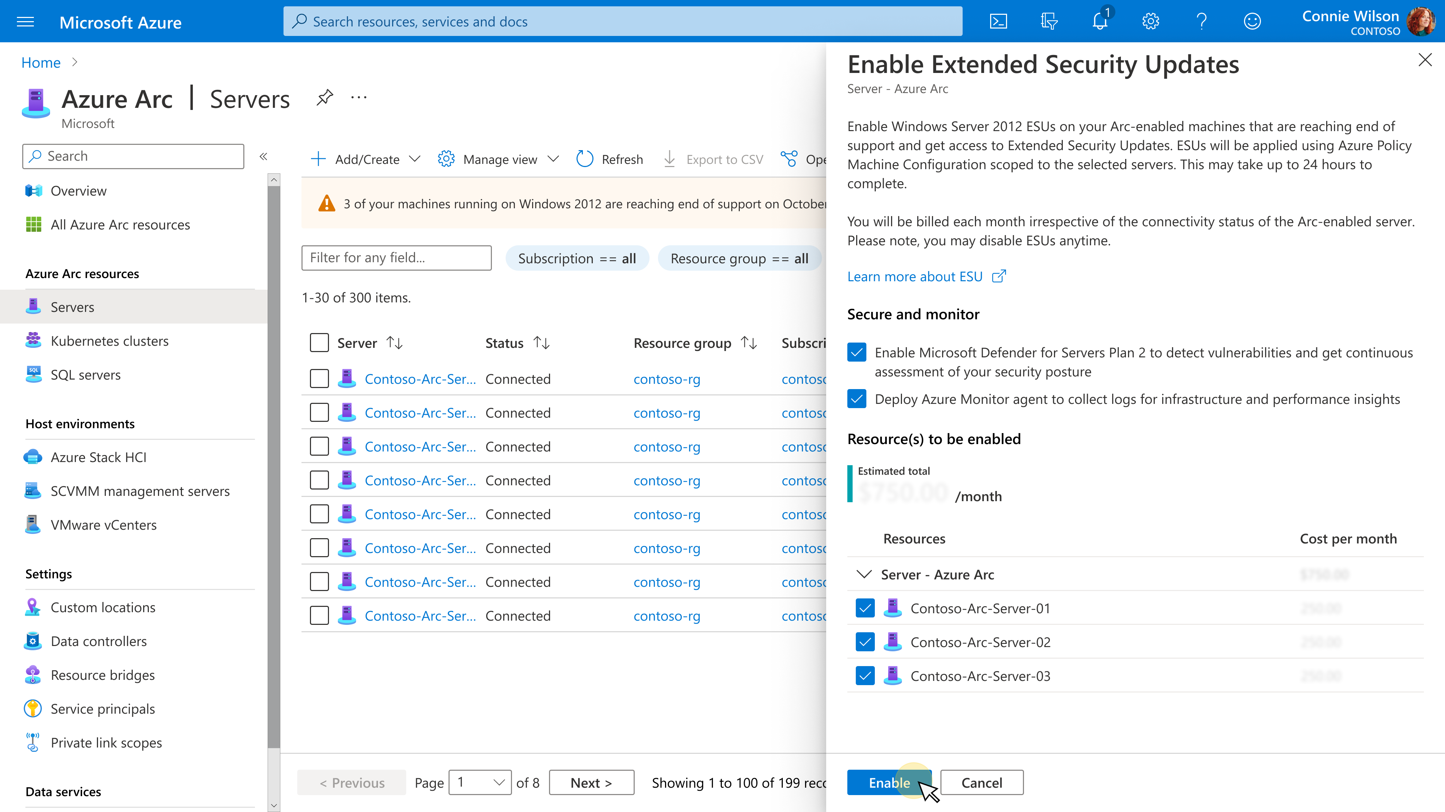




Extended Security Updates enabled by Azure Arc
Flexible billing and savings
Monthly billing model centralized in Azure to run end-of-support operating systems
Visibility and reliability
Ensure consistent Windows Server 2012/R2 and SQL Server 2012 performance with high availability and visibility over your entire data and server estate
Security and compliance
Seamlessly extend Azure security and governance to your environment and stay compliant with supported software
Microsoft Defender for Cloud
Microsoft Sentinel
Azure Policy
Azure Monitor
Enroll and purchase ESUs directly in the Azure Portal
Notes:
Single portal experience including opt-in into Azure Monitor & Defender for Cloud

Slide 3
Windows Server and SQL Server 2012 EOS/ESU Conversation Flow
11.000 on WS 2012
In Lidl Stores
In a Nutshell:
At least one App prevent WS modernization
Server need to stay on prem
If we will not offer Azure ARC ESU, they have to work with the unsupported WS 2012 until Apps are ready for WS2019 or above
Customer already bought WS 2019 lic (without SA) which are still not in use based on the App Issue
If we are able to offer Azure ARC Azure we can create ~400-500k monthly ACR (for at least 12 months) otherwise we will see no additional revenue
Missing SA prevents us to offer Azure ARC ESU, need exception
Yes
No
Move to public Azure
Can my workload migrate to Azure?
Remain on-prem
Move to Azure
Options
Modernize in place with
Arc SQL MI
Upgrade to WS/SS2022
Remain on-prem on 2012
PaaS or IaaS
No ESU needed
N
Y
Connect to
Azure Arc
Azure SQL MI
Azure IaaS
Azure App Service
Dedicated Host
Standard Offer
Arc enabled Offer
Azure Stack HCI
Active SA is required
Active SA is required
No ESU needed
Free ESU
No ESU needed
Paid ESU
Paid ESU

